Slide 1

HOUSING PRICE PREDICTION PROJECT
A case study from US-based housing company named “Surprise Housing”. The company is looking at prospective properties to buy houses at a price below their actual values and flip them at a higher price which will help the company to enter the real estate market.
PRESENTATION
Submitted by G. PREMSAGAR
Data Science Intern Flip Robo Technologies

Slide 2
ACKNOWLEDGMENT
I'd like to express my heartfelt gratitude to my SME (Subject Matter Expert) Khushboo Garg, as well as Flip Robo Technologies, for allowing me to work on this project on Surprise Housing Price Prediction, as well as for assisting me in conducting extensive research that allowed me to learn a lot of new things.
In addition, I used a few other resources to assist me finish the job. I made sure to learn from the samples and adjust things to fit my project's needs.

Slide 3
INTRODUCTION
Surprise Housing is a US based Real estate and housing company who is trying to entry into Australian Real estate market. The company is looking at prospective properties to buy houses to enter the market. We are required to build a model using Machine Learning in order to predict the actual value of the prospective properties and decide whether to invest in them or not.
For this Surprise Housing wants to know:
Which variables are important to predict the sale price of house?
How do these feature variables describe the price of the house?

Slide 4
AGENDA
Analytical Problem Framing
Exploratory Data Analysis (EDA)
Visualizations
Data Pre-Processing on train and test datasets
Model/s Development and Evaluation
Performing hyper parameter tuning, saving the best model and predicting the label
Conclusion and future work discussion

Slide 5
Hardware - Software Requirements and Tools Used
Hardware technology being Used:-
CPU: MacBook Pro
Chip: Apple M1 - 8 (4 performance and 4 efficiency)
GPU: 8 GB
RAM: 8 GB
Software Technology being Used:-
Programming language: Python
Distribution: Anaconda Navigator
Browser based language shell: Jupyter Notebook
Libraries/Packages Used:-
Pandas, NumPy, matplotlib, seaborn, scikit-learn and pandas_profiling

Slide 6
PROBLEM STATEMENT
Houses are one of the necessary need of each and every person around the globe and therefore housing and real estate market is one of the markets which is one of the major contributors in the world’s economy. It is a very large market and there are various companies working in the domain.
Data science comes as a very important tool to solve problems in the domain to help the companies increase their overall revenue, profits, improving their marketing strategies and focusing on changing trends in house sales and purchases.
Predictive modelling, Market mix modelling, recommendation systems are some of the machine learning techniques used for achieving the business goals for housing companies. Our problem is related to one such housing company.

Slide 7
ANALYTICAL PROBLEM FRAMING
As we are provided with two sets of data, one is for training and other for testing. Here we need to build a machine learning model using train dataset and then by using that model we will make predictions for test dataset.
Both the datasets are in csv format, train dataset has 1168 rows and 81 columns whereas test dataset has 292 rows and 80 columns. Here in the test dataset we do not have the target label and need to predict the same.
And as we have to predict house sale prices in this problem which is a continuous data, I will be using different regression machine learning models.

Slide 8
DATA ANALYSIS - MODEL BUILDING FLOWCHART
Import Dependencies or Libraries
Data set Collection
Data preprocessing
Encoding
EDA and Visualization
Checked for Null Values
Checked for correlation
Checked for Outliers/Skewness
Proceed for Model building
Saving the Final_Model
Hyper Parameter Tuning
R2 Score, Cross Validation Score, MSE, RMSE, MAE

Slide 9
DATA PRE PROCESSING
Importing the required libraries and dependencies.
The CSV file was read and turned into a data frame.
Checking the original dataset's data dimensions.
Look for null values and fill up the blanks accordingly.
Examining the dataset's summary.
Checking for distinct values.
Checking all of the dataset's category columns.
Using matplotlib and seaborn to visualize each feature.
On categorical characteristics, the ordinal encoder is used to do encoding.
In a heatmap, look for co-relation/multi-collinearity.
Using a boxen plot and a distribution plot, look for outliers or skewness.
Scale using the Standard Scaler technique.
Confirming the input information by looking at the dataset's final dimension.
Making a train test split and determining the optimum random state in the range of 1-1000.

Slide 10
EXPLORATORY DATA ANALYSIS (EDA) AND VISUALIZATION
01. Univariate Analysis
Univariate analysis is the simplest form of analyzing data. “Uni” means “one”, so in other words your data has only one variable.
02. Multivariate Analysis
Multivariate analysis is a set of statistical techniques used for analysis of data that contain more than one variable.
03. Correlation of Dataset
Correlation is used to test relationships between quantitative variables or categorical variables.
05. Conclusion
04. Correlation with Target variable
Correlation with the target variable to know how the data is related.
Summary with the conclusion of all the analysis

Slide 11
PIE PLOT
A Pie Chart is a circular statistical layout that can only show one set of data at a time.
The overall percentage of the provided data is represented by the chart's area.
The proportion of sections of the data is represented by the area of the pie slices.

Slide 12
COUNT PLOT
The count plot approach uses bars to represent the counts of data in each category bin.
parameters: This technique takes the following parameters, which are listed below: x, y
This parameter accepts the names of data variables or vector data as optional inputs when graphing long-form data.

Slide 13
SCATTER PLOT
Scatter plots are used to visualise the relationship between variables, with dots representing the association.
A scatter plot is created using the matplotlib library's scatter function.
Scatter plots are commonly used to depict the relationship between variables and how one impacts the other.

Slide 14
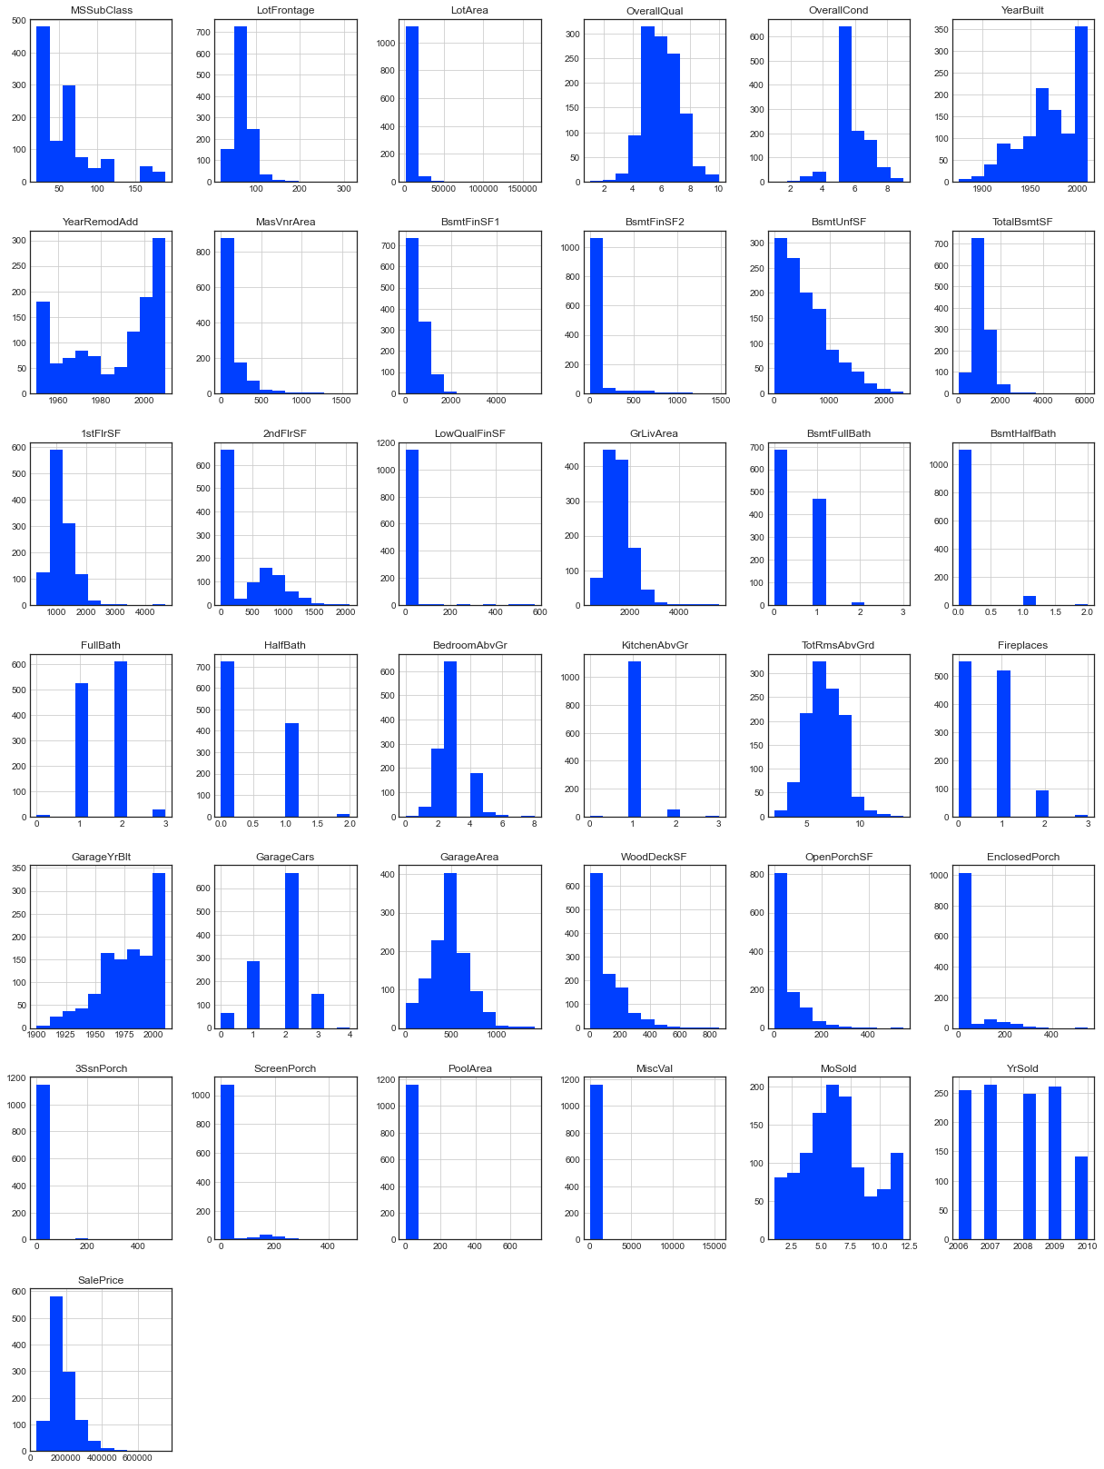
HISTOGRAM
A histogram is a visual representation of data presented in the form of groupings.
It is a precise approach for displaying numerical data distribution graphically.
It's a sort of bar plot in which the X-axis shows bin ranges and the Y-axis represents frequency.

Slide 15
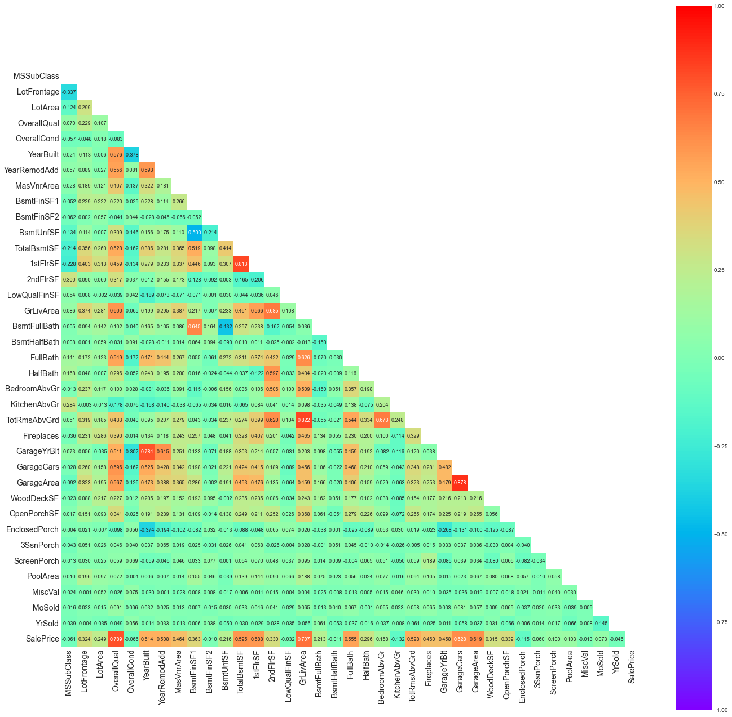
HEATMAP
For each value to be plotted, a heatmap has values indicating several shades of the same hue.
The deeper hues of the chart usually correspond to greater values than the lighter shades.
A entirely different hue can likewise be utilised for a significantly different value.

Slide 16
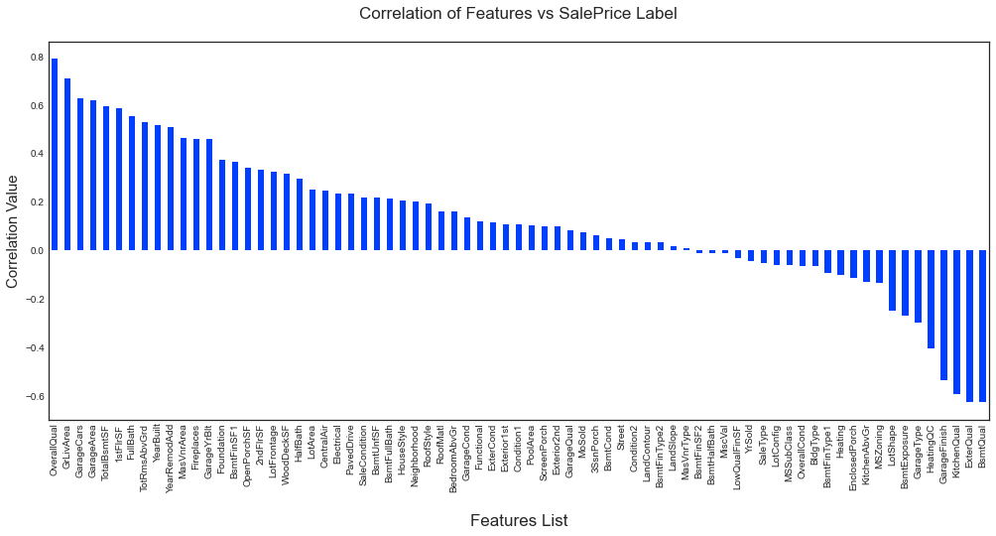
BAR GRAPH
Bar graphs are used to compare two groupings of data or to follow changes over time.
In this case, the correlation values between the feature columns and the target label column, which is Sale Price in our instance, are being compared.
It reveals the information of positive and negative associated columns.

Slide 17
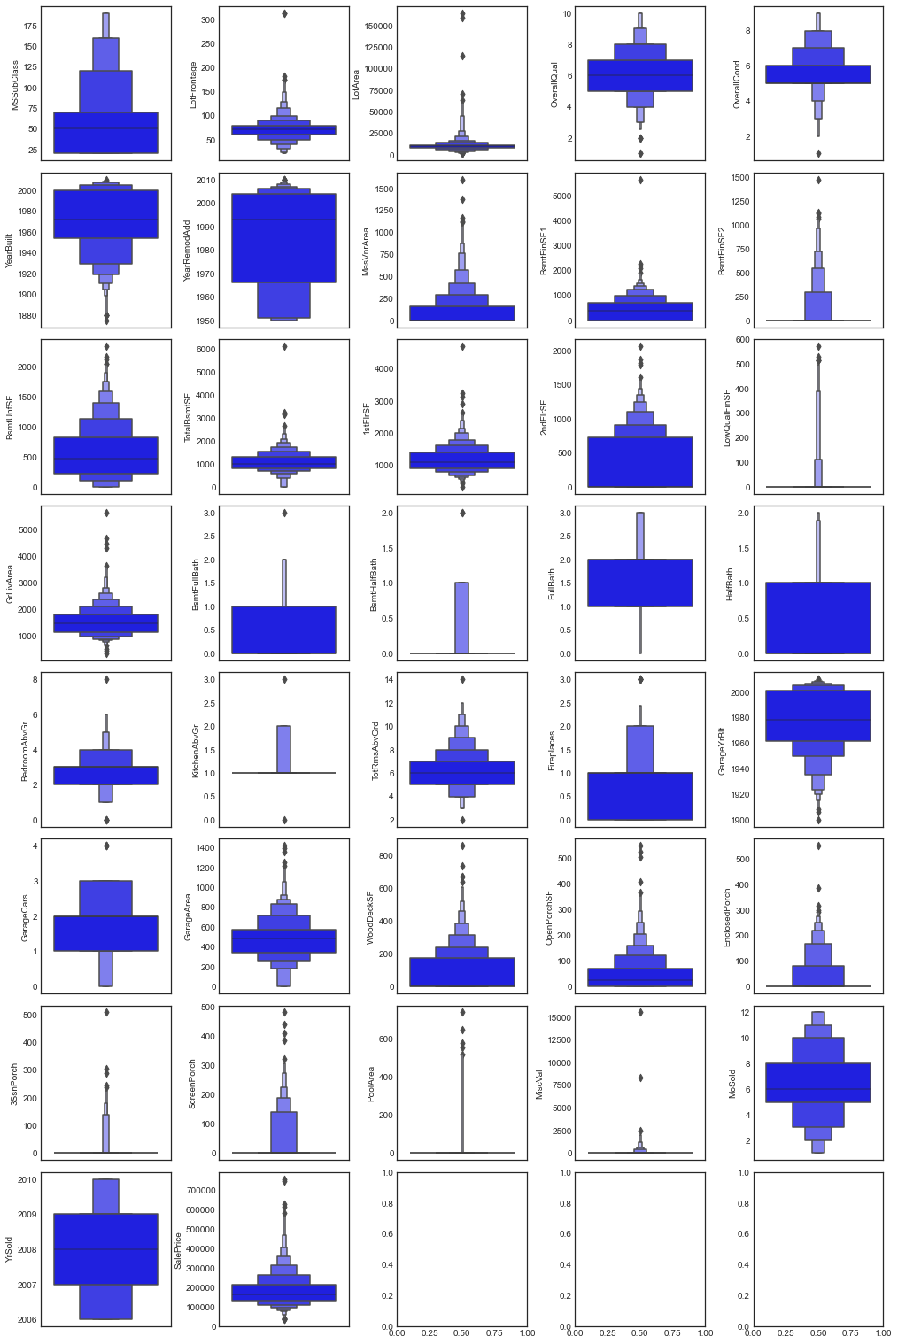
BOXEN PLOT
A Boxen Plot, also known as a Whisker Plot, is used to show a summary of a group of data values that include attributes such as minimum, first quartile, median, third quartile, and maximum.
We utilised it to find outlier information for all numeric datatype column values.

Slide 18
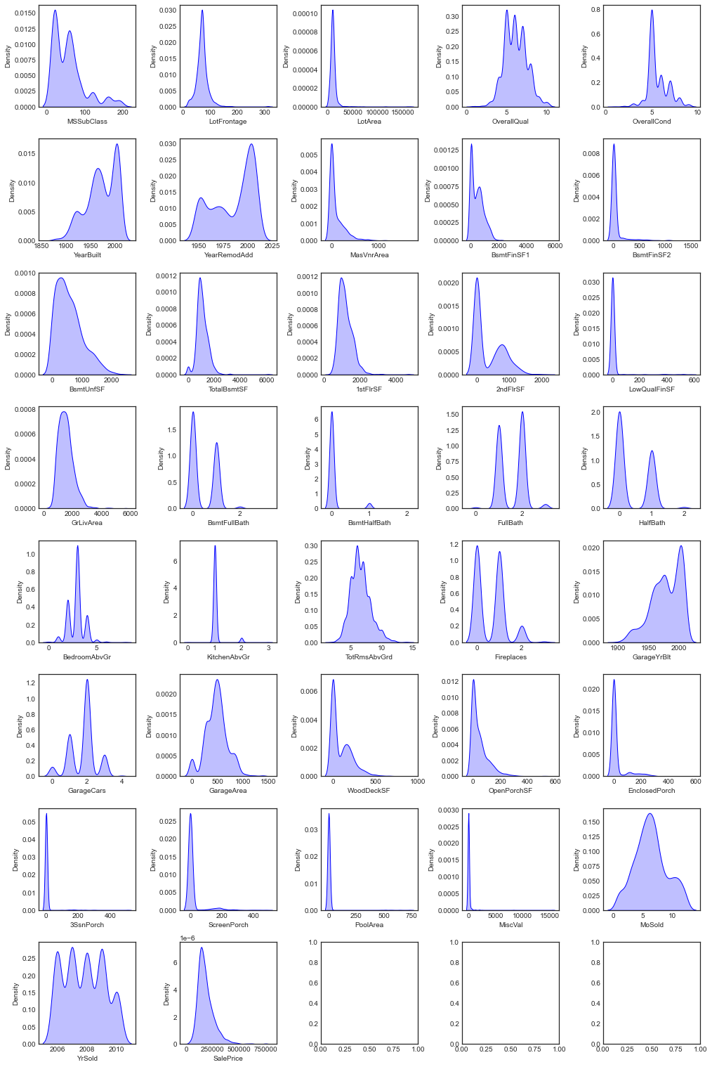
DISTRIBUTION PLOT
Distribution plots compare the empirical distribution of sample data with the theoretical values anticipated from a specific distribution to visually analyze the distribution of sample data.
It was utilized to examine the skewness information for numeric datatype column values in this case.
A normal distribution resembling a bell shape curve is typically suitable.

Slide 19
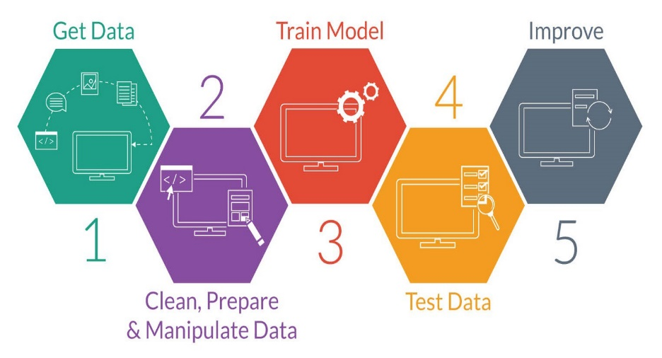
MODEL TRAINING PHASES

Slide 20
MODEL/S DEVELOPMENT
The algorithms used on training and test data are as follows:-
Linear Regression Model
Ridge Regularization Regression Model
Lasso Regularization Regression Model
Support Vector Regression Model
Decision Tree Regression Model
Random Forest Regression Model
K Nearest Neighbours Regression Model
Gradient Boosting Regression Model
Ada Boost Regression Model
Extra Trees Regression Model

Slide 21
EVALUATION AND HYPER PARAMETER TUNING
The key metrics used here were:
R2 score
Cross Validation Score
MAE
MSE
RMSE
Using Hyperparameter Tuning, we sought to discover the optimal parameter list to improve our accuracy ratings.
We utilized the Grid Search CV technique with 5 folds to attain a higher score.

Slide 22
CONCLUSION AND SCOPE FOR FUTURE WORK
Throughout this research, I ran into a difficulty with a lack of data to train machine learning models on.
Many columns have the identical data in more than 80% of the rows, causing our model's performance to suffer.
Another difficulty is that this data collection has a big number of missing values, thus we must manually fill those missing values in the proper manner.
With some feature engineering and thorough hyper-parameter adjustment, we can still increase the accuracy of our model.

Slide 23


